Slide 1
Welcome to the
African Heritage Diet
Grocery Store Tour

Slide 2
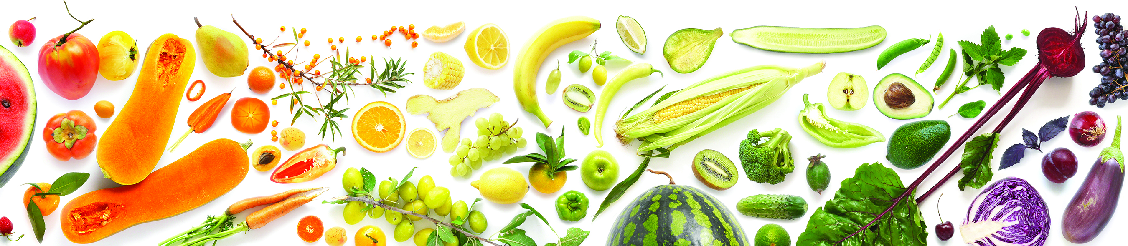
Southern Diet vs. African Heritage Diet
A “southern diet” or “soul food diet” of fried food, processed meats, added fats, and sugar sweetened beverages is often seen as the traditional diet for many African Americans.
But in fact, a healthier, more solidly traditional model can be found by looking to the foods brought to the New World by Africans, along with those they adopted.

Slide 3
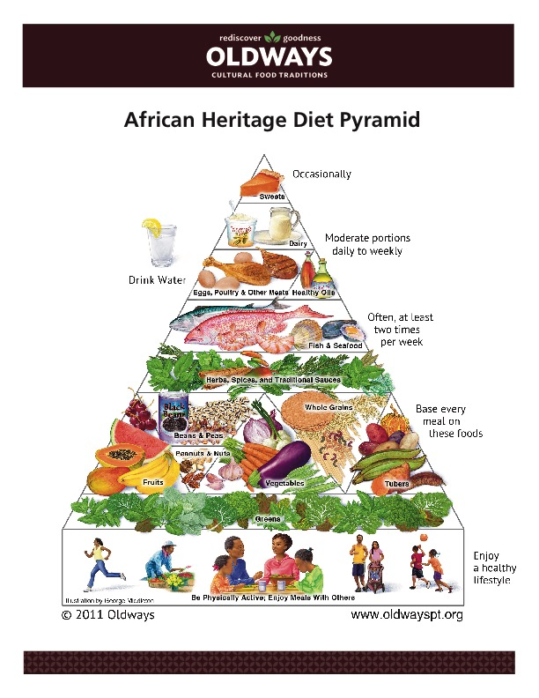

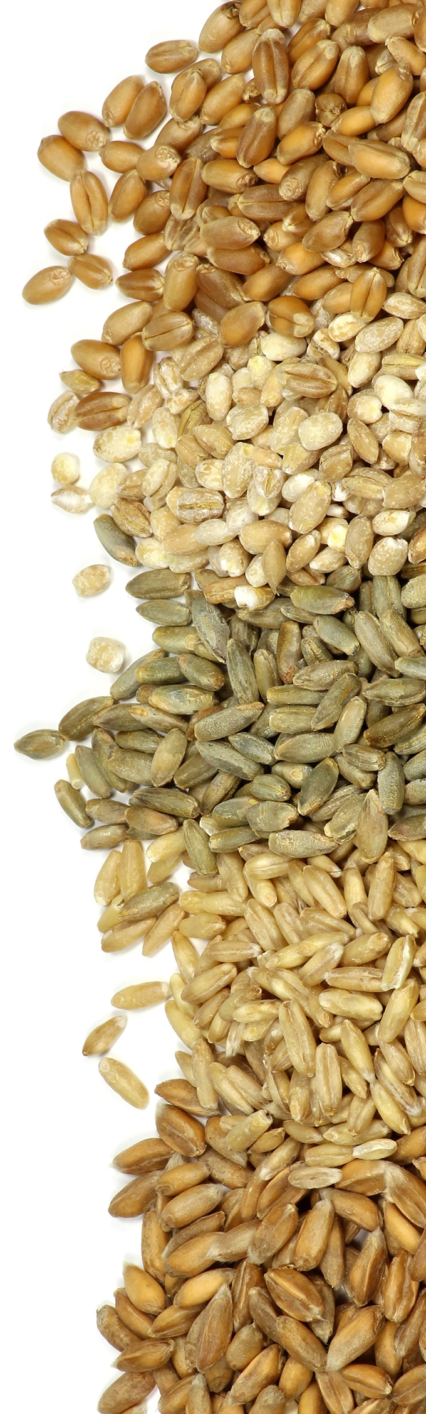
Notes:
As the Pyramid illustrates, the African Heritage diet is based on whole, fresh plant foods like colorful fruits and vegetables, especially leafy greens; tubers like yams and sweet potatoes; beans of all kinds; nuts and peanuts; rice, ﬂatbreads and other grain foods, especially whole grains; healthy oils; homemade sauces and marinades of herbs and spices; ﬁsh, eggs, poultry and yogurt. It’s naturally low in processed sugar, unhealthy types of fats, and sodium, and includes only small amounts of meats and sweets. Whether we look to Virginia or Jamaica, Nigeria or Brazil, we ﬁnd this overall healthy eating pattern shared by all of their culinary histories, with distinct foods featured by each region.

Slide 4
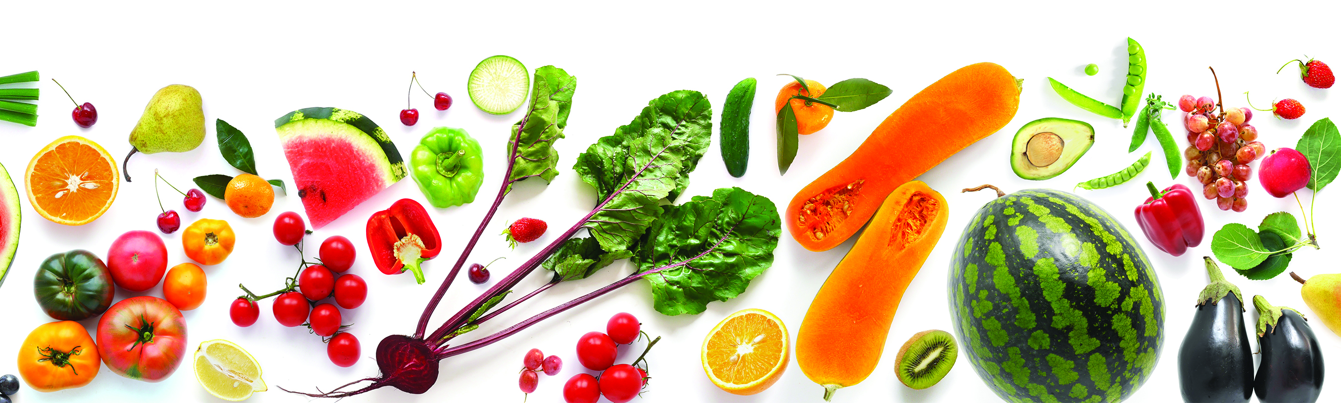
Drawing From Across the African Diasora
Africa
Peanut Soup
Chicken Yassa
Jollof Rice
South America
Vegetable Rice Soup
Black Beans & Rice
Moqueca De Peixe
American South
Shrimp Gumbo
Hoppin’ John
Collards
Pecan Catfish
Caribbean
Pumpkin Soup
Red Beans & Rice
with Coconut Milk
Snapper with Mango
Lime Vinaigrette
Notes:
African Diaspora is the term used to describe the mass dispersion of peoples from Africa (primarily Western and Central Africa) to different regions throughout the Americas and the Caribbean primarily during the Transatlantic Slave Trades, from the 1500s to the 1800s. The ancestors of African Americans brought many wonderful food traditions to parts of the Caribbean, South America, and the southern states of the U.S. The combination of these traditional foods, along with the foods they adopted, resulted in a resourceful, nutrient-dense culinary tradition rooted in wholesome plant foods. This practice of bridging culinary traditions continues today.

Slide 5

10 Steps for Your Health Through Heritage
Boost flavor with spice.
Make vegetables the star of your plate.
Change the way you think about meat.
Make rice & beans your new staple.
Embraces mashes & medleys.
Find real foods everywhere.
Share family support & food fellowship.
Make room for celebration foods.
Center dessert around fruits.
Jazz up water with fresh fruits.
Notes:
Boost Flavor With Spice. Curries, peppers, coconut, fresh herbs, garlic, onions, fresh lemon, and all spices are low-sodium ways to add incredible ﬂavors to grains, beans, vegetables, and seafood. Try a diﬀerent herb every week for a touch of African heritage.
Make Vegetables the Star of Your Plate. Steamed, sautéed, roasted, grilled or raw, enjoy veggies like okra, cabbage, green beans, or eggplant in larger portions than the other parts of your meal. If you’re grabbing seconds, go for the veggies!
Change the Way You Think About Meat. Use lean, healthy meats in smaller amounts for ﬂavor. Replace ham-hocks with smoked turkey or ﬁsh, or pile on the herbs and spices instead! With the zesty ﬂavors of African heritage, you may not even notice the meat’s not there. We’ve got plenty of vegetarian recipes and a guide to help you on the Oldways website.
Make Rice & Beans Your New Staple. Fiber-ﬁlled Rice-and-Beans is a favorite meal all over the world. Add African heritage whole grains like millet, sorghum, and teﬀ to your soups, or partner them with peas.
Enjoy Mashes & Medleys. Bake or boil sweet potatoes, yams and potatoes or mash them with eggplants, beans, grains, onions, and seasonings. One-Pot Cooking lets ﬂavors sing together! Let okra, corn, and tomatoes collide in a “Mix Up,” or add extra color and ﬂavor to your greens with purple cabbage and leeks.
Find Real Foods Everywhere. At a corner store, buy peanuts or fruit; at a lunch buﬀet, load up your plate with salad, veggies, fruit, and beans. Look to African heritage whole foods, in their natural state, to crowd out processed and packaged “convenience foods.”
Family Support & Food Fellowship. Food is meant to be shared, and so is good health. Think of your dinner table as a “healing table,” a place where people come to share beautiful, fresh foods and reinforce a long, happy and healthy life.
Make Room for Celebration Foods. We all have special foods that have always been in our families. Some of these foods may fall outside the guidelines of the African Heritage Pyramid. Save these foods of meaning and memory for special occasions. Enjoy them infrequently, but when you do have them, enjoy them whole-heartedly!
Jazz Up Fruits for Dessert. Fresh or frozen fruits like melons, peaches, berries, and mangos—plain or sprinkled with chopped nuts or coconut—add a sweet taste of satisfaction at the end of a meal.
Drink to Your Health. A splash of ﬂavor can make water your go-to drink. Add crushed fruits or small amounts of 100% fruit juice to water or sparkling water to make refreshing “ades” (like lemonade!). Iced tea with a little honey is another refreshing alternative to soda and other highly sugared drinks.

Slide 6
Thank you!
Learn more at www.oldwayspt.org

